Slide 1
Segmentation - Split and Merge

Slide 2
Objectives
Learn segmentation techniques using the Split and merge method.
Watershed technique.
Region methods: splitting, merging.
Graph-based segmentation.
Probabilistic aggregation.

Slide 3

What are different?
Threshold: single threshold is rarely sufficient for the whole image because of lighting and intra-object statistical variations
Using recursively splitting the whole image into pieces based on region statistics or, conversely, merging pixels and regions together in a hierarchical fashion.
It is also possible to combine both splitting and merging by starting with a medium-grain segmentation and then allowing both merging and splitting operations.
Notes:
These points where the image brightness varies sharply are called the edges (or boundaries) of the image.

Slide 4
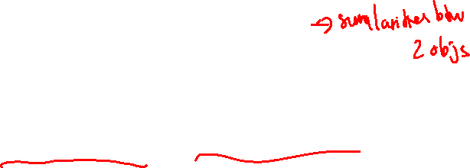
Split and merge Segmentation
Algorithm:
Define the criterion to be used for homogeneity
Split the image into equal size regions
Calculate homogeneity for each region
If the region is homogeneous, then merge it with neighbors
The process is repeated until all regions pass the homogeneity test
Notes:
Homogeneity is a sameness of constituent structure.

Slide 5

Watershed
A watershed is a transformation defined on a grayscale image.
The name refers metaphorically to a geological watershed, or drainage divide, which separates adjacent drainage basins.
The watershed transformation treats the image it operates upon like a topographic map, with the brightness of each point representing its height, and finds the lines that run along the tops of ridges.

Slide 6
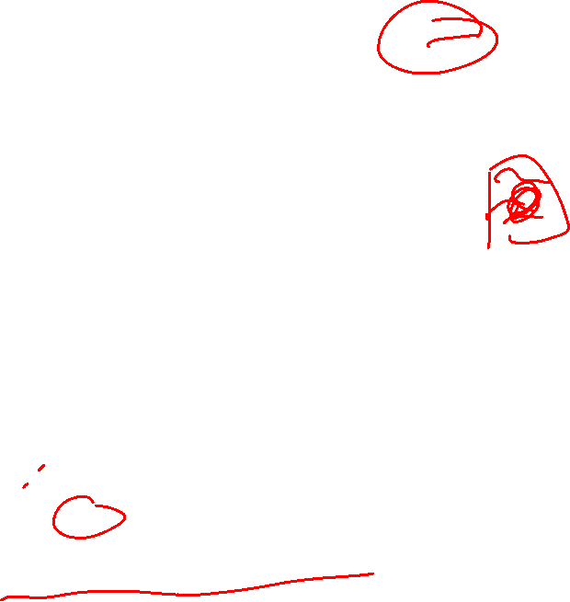
Watershed
To understand the watershed, one can think of an image as a surface:
The bright pixels represent mountaintops
The dark pixels valleys
The surface is punctured in some of the valleys, and then slowly submerged into a water bath
The water will pour in each puncture and start to fill the valleys
However, the water from different punctures is not allowed to mix, and therefore the dams need to be built at the points of first contact
These dams are the boundaries of the water basins, and also the boundaries of image objects
Notes:
To understand the watershed, one can think of an image as a surface where the bright pixels represent mountaintops and the dark pixels valleys. The surface is punctured in some of the valleys, and then slowly submerged into a water bath. The water will pour in each puncture and start to fill the valleys. However, the water from different punctures is not allowed to mix, and therefore the dams need to be built at the points of first contact. These dams are the boundaries of the water basins, and also the boundaries of image objects

Slide 7
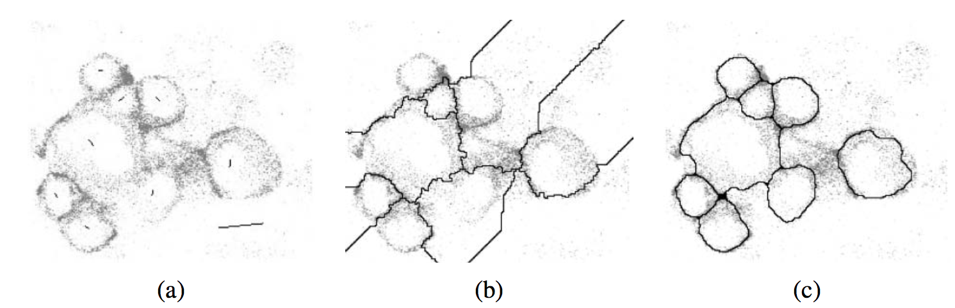

Watershed
Notes:
Locally constrained watershed segmentation (Beare 2006) ⃝c 2006 IEEE:
original confocal microscopy image with marked seeds (line segments);
(b) standard water- shed segmentation;
(c) locally constrained watershed segmentation.

Slide 8
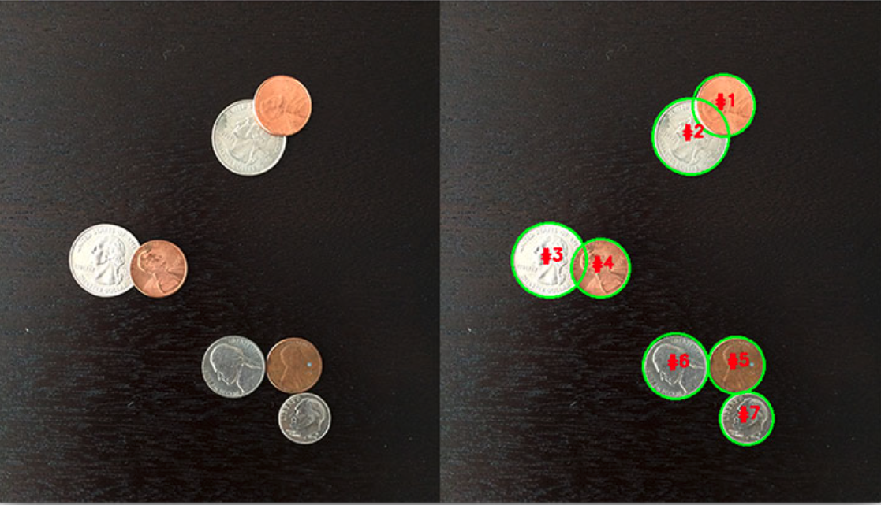

Watershed
Notes:
The watershed algorithm is able to segment the overlapping coins from each other.

Slide 9
Region Splitting
Region Splitting: The basic idea of region splitting is to break the image into a set of disjoint regions which are coherent within themselves
Region Splitting process:
Initially take the image as a whole to be the area of interest.
Look at the area of interest and decide if all pixels contained in the region satisfy some similarity constraint.
If TRUE then the area of interest corresponds to a region in the image.
If FALSE split the area of interest (usually into four equal sub-areas) and consider each of the sub-areas as the area of interest in turn.
This process continues until no further splitting occurs. In the worst case this happens when the areas are just one pixel in size.
Notes:
Image Segmentation techniques make a MASSIVE impact here. They help us approach this problem in a more granular manner and get more meaningful results.

Slide 10
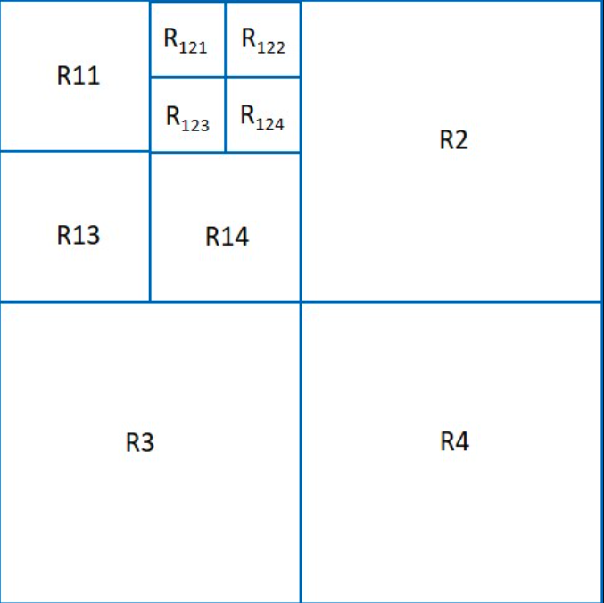
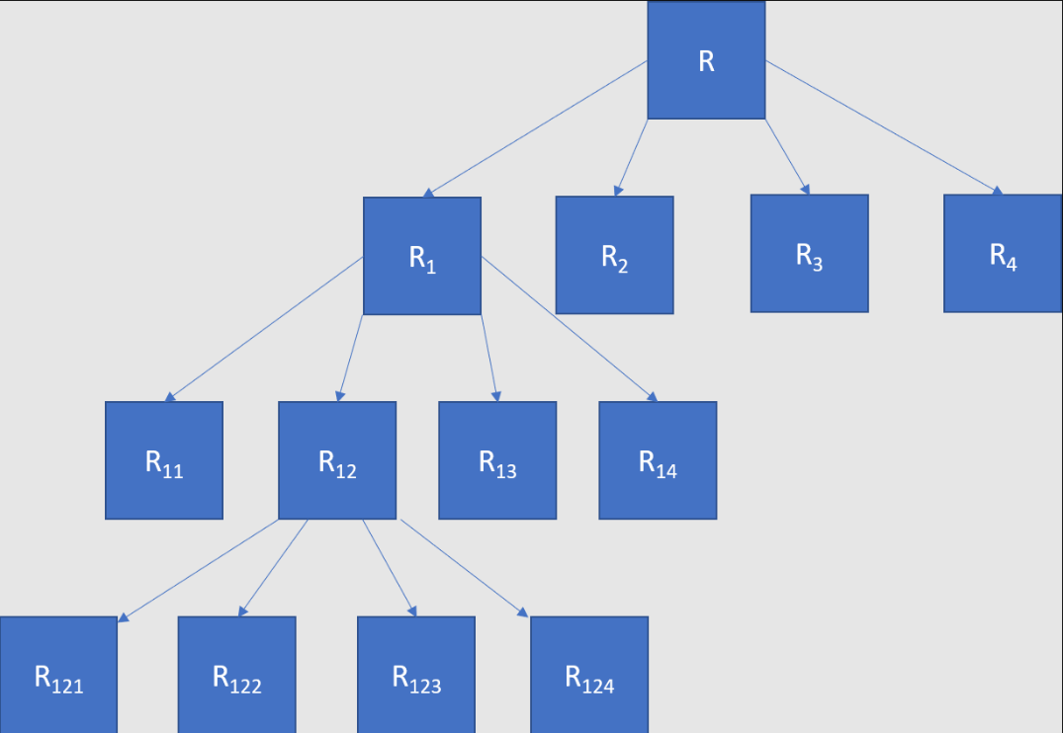
Region Splitting

Slide 11
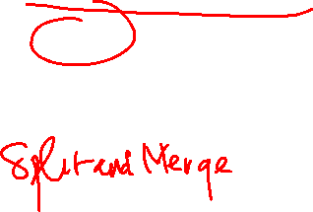
Region Splitting is enough?
Region splitting only: the final segmentation would probably contain many neighbouring regions that have identical or similar properties.
A merging process is used after each split which compares adjacent regions and merges them if necessary
Notes:
Image Segmentation techniques make a MASSIVE impact here. They help us approach this problem in a more granular manner and get more meaningful results.

Slide 12

Region Splitting and Merging
R123

Slide 13
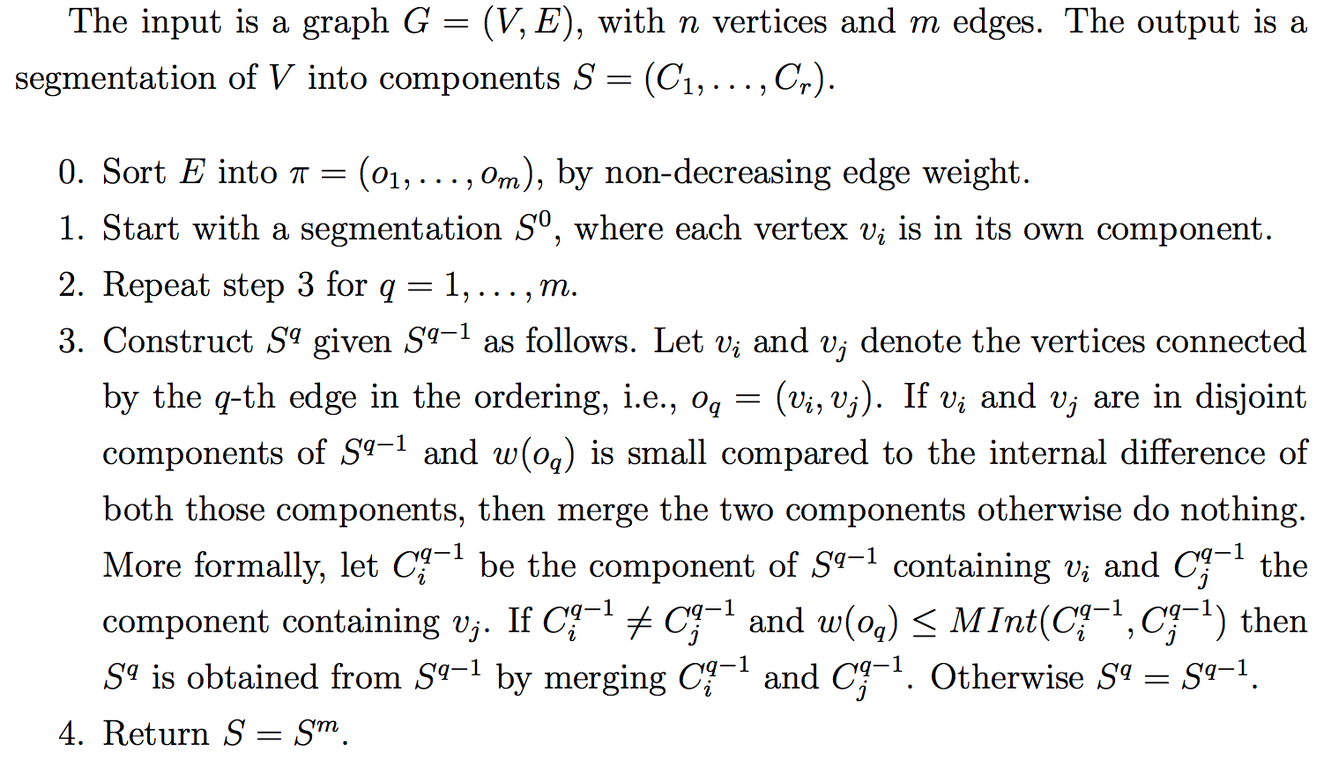

Graph-based Segmentation
Notes:
Image Segmentation techniques make a MASSIVE impact here. They help us approach this problem in a more granular manner and get more meaningful results.

Slide 14
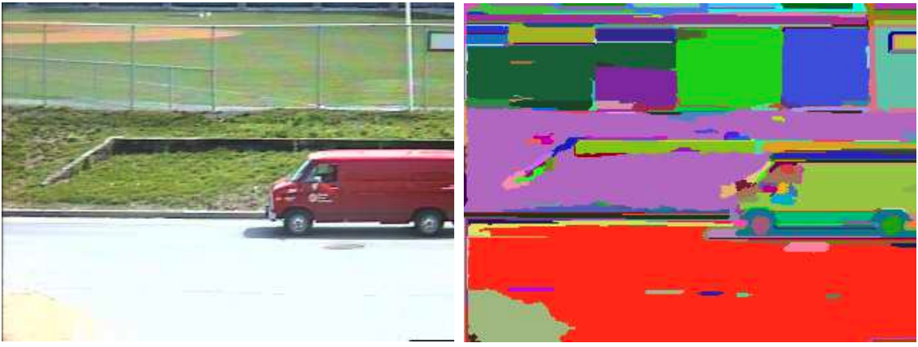
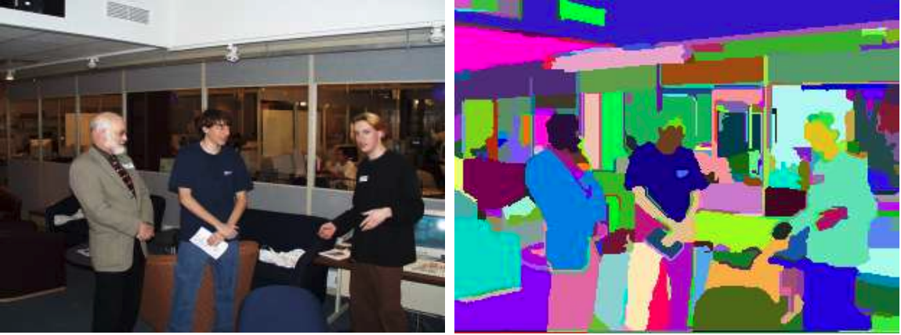
Graph-based Segmentation
Notes:
Up: A street scene (320 × 240 color image), and the segmentation results produced by our algorithm (σ = 0.8, k = 300).
Down: An indoor scene (image 320 × 240, color), and the segmentation results produced by our algorithm (σ = 0.8, k = 300).

Slide 15
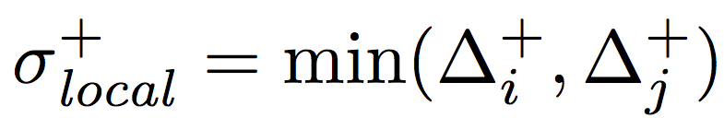
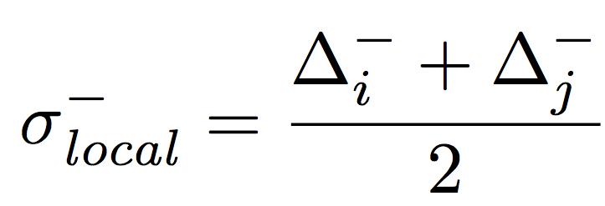

Probabilistic Aggregation
Probabilistic merging algorithm based on two cues, namely gray-level similarity and texture similarity.
The gray-level similarity between regions Ri and Rj is based on the minimal external difference from other neighboring regions
This is compared to the average intensity difference:

Slide 16
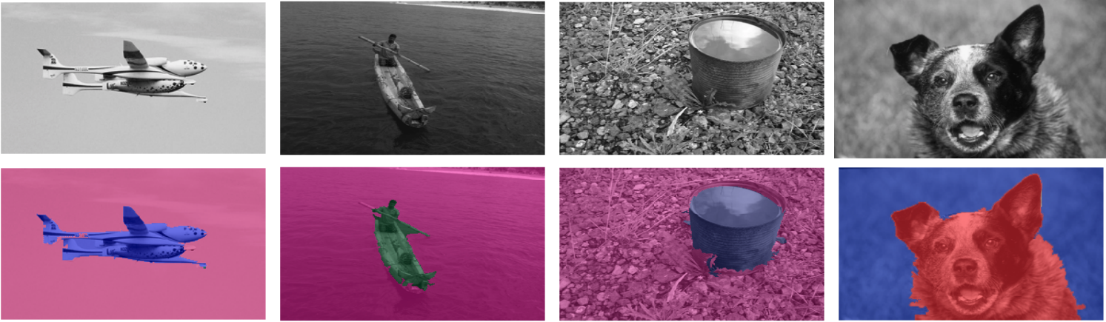
Probabilistic Aggregation
The texture similarity is defined using relative differences between histogram bins of simple oriented Sobel filter responses. The pairwise statistics σ+ and σ− are used to compute the likelihoods pij that two regions should be merged

Slide 17
Summary
Learn segmentation techniques using the Split and merge method.
Watershed technique.
Region methods: splitting, merging.
Graph-based segmentation.
Probabilistic aggregation.

